Slide 1
UE22CS441A – Project Phase – 3
END SEMESTER ASSESSMENT
Detection And Mitigation Of Replay Attacks
Project ID
49
Project Guide
Dr. Manju
Project Team:
Mohit Prasad Singh (PES2UG22CS320)
Shreyas S (PES2UG22CS540)
Soumya Ranjan Mishra (PES2UG22CS571)
Suhas Venkata (PES2UG22CS590)

Slide 2
Outline
Abstract
Summary of Requirements and Design
Summary of Methodology / Approach
Design Description
Modules and Implementation Details
Project Demonstration and Walkthrough
Results and Discussion (include comparison with existing work)
Lessons Learnt
Conclusion and Future Work
Project Abstract
Project Poster
References

Slide 3
Abstract
CCTV systems are vital for surveillance across sectors like banking, transportation, healthcare, and public safety. However, they face growing cyber threats, especially replay attacks, where intercepted video or data streams are retransmitted to deceive the system. This leads to unauthorized access, footage tampering, and compromised surveillance integrity, exposing the need for robust security enhancements. This project proposes an AI-based detection and response system to mitigate replay attacks by integrating machine learning and cryptographic security measures. Key components include:
Secure Communication Protocols: Encrypting data and verifying stream authenticity.
AI-Powered Anomaly Detection: Identifying timestamp and frame inconsistencies in video streams.
Real-Time Automated Response: Alerting admins, isolating compromised devices, and blocking threats.
Modular Design: Seamlessly integrating with existing infrastructures. The system undergoes vulnerability assessments, machine learning model training, and rigorous testing to ensure effectiveness, scalability, and ease of use. Expected outcomes include improved replay attack detection, enhanced CCTV security, and greater trust in surveillance technologies, making this a significant step towards adaptive, secure surveillance solutions.

Slide 4
Summary of Requirements
Simulation: Generate realistic replay attacks by switching RTSP streams based on motion intensity.
Preprocessing: Convert live video into Sparse Distributed Representations (SDRs) using optical flow.
Detection: Utilize Hierarchical Temporal Memory (HTM) to predict sequences and score anomalies in real-time.
Mitigation: Implement a "Gatekeeper" to store SHA-256 hashes of trusted frames and block anomalies.
Alerting: Provide immediate logs and a dashboard interface for administrative monitoring.
Performance: Ensure real-time operation (Low Latency) with high reliability.
Scalability & Portability: Modular design deployable on Linux/Windows environments.

Slide 5
Background
Approach | Strengths | Weaknesses/Gaps
Deep Learning (CNN, LSTM, Autoencoder) | High accuracy for spatial and some temporal anomalies. Learns complex patterns. Scales well to big datasets. | Requires large labeled datasets. High compute cost. Fails on context-based replay attacks (normal frames at wrong time). Not interpretable.
Video Hashing & Watermarking | Strong for detecting content duplication and classical tampering. Can verify source fidelity. | Ineffective for replay attacks using previously recorded normal footage. Needs video modification or prior knowledge. Not real-time.
HTM / Grid HTM-Based Methods | Excellent unsupervised modeling of temporal context and sequence anomalies. Efficient, incremental, interpretable. | Prior work focuses on general anomaly detection in video/time-series; not specifically replay attack detection for surveillance videos.

Slide 6
Design Details
Input Module: Accepts live or recorded CCTV video streams for analysis.
Optical Flow Extraction: Calculates motion vectors between consecutive frames to capture movement patterns.
SDR Encoding: Converts optical flow data into Sparse Distributed Representations (SDRs) suitable for HTM processing.
HTM Anomaly Detection: Learns temporal motion sequences and generates real-time anomaly scores when deviations occur.
Perpetual Hashing: Continuously generates hash values for each frame to detect repeated or tampered content, even under minor variations.
Alert Generation Logic: Combines HTM anomaly scores and hash matches using adaptive thresholds and persistence logic to trigger reliable alerts.
Logging and Reporting: Records frame-wise anomaly scores, hash values, and alert status for post-event analysis.
Modular Implementation: Developed in Python with separate modules for preprocessing, inference, hashing, and alert management, ensuring scalability and ease of integration.

Slide 7
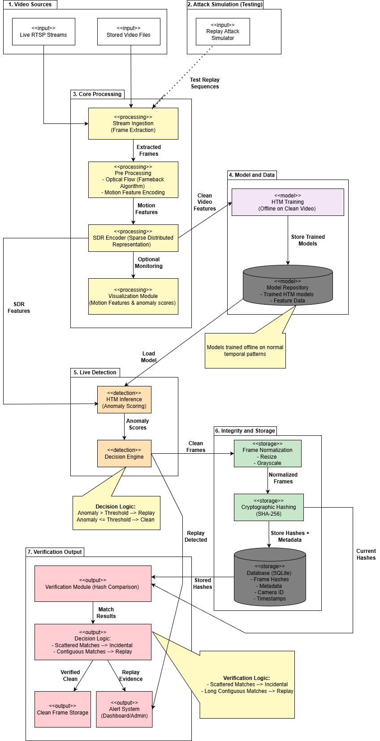
Model Architecture

Slide 8
Details of the approach- benefits/drawbacks
This project adopts a hybrid detection framework combining Hierarchical Temporal Memory (HTM) for motion anomaly detection and perpetual hashing for content verification in CCTV footage. The pipeline begins with optical flow extraction to capture motion between frames. These motion vectors are encoded into Sparse Distributed Representations (SDRs) and processed by HTM, which learns temporal patterns and flags deviations as anomalies. Simultaneously, perpetual hashing generates consistent hash values for each frame, enabling the detection of repeated or tampered content even under minor visual changes. An alert logic module fuses HTM scores and hash matches using adaptive thresholds and persistence logic to trigger reliable alerts.

Slide 9
Benefits and Drawback
Benefits:
Unsupervised Learning: HTM does not require labeled data, making it adaptable to new environments.
Robust Replay Detection: Perpetual hashing detects repeated content even with slight modifications or compression.
Low False Positives: Adaptive thresholding and persistence logic improve alert accuracy.
Modular Design: Easy to scale or integrate with existing CCTV infrastructure.
Drawbacks:
Sensitivity to Noise: Optical flow can be affected by lighting changes or camera jitter.
Parameter Tuning: HTM requires careful tuning for optimal performance.
Limited Context Awareness: The system may struggle with complex scenes involving overlapping motion patterns.
Computational Overhead: Real-time hashing and HTM processing can be resource-intensive on low-end hardware.

Slide 10
Algorithm Used
1. Hierarchical Temporal Memory (HTM) – for unsupervised anomaly detection in motion patterns.
2. Perpetual Hashing – for frame-level content verification to detect replayed or tampered footage.

Slide 11
Logical Flow
The CCTV video input is received and preprocessed by extracting and resizing frames for consistency.
Optical flow is applied to consecutive frames to capture motion vectors representing pixel-level movement.
The motion vectors are encoded into Sparse Distributed Representations (SDRs) for compatibility with the HTM model.
The HTM model processes the SDRs to learn temporal motion patterns and generates anomaly scores in real time.
Perpetual hashing is applied to each frame to generate consistent hash values for detecting repeated or tampered content.
An alert generation module combines HTM anomaly scores and hash comparisons using adaptive thresholds and persistence logic to trigger alerts.
All results, including anomaly scores, hash values, and alerts, are logged and can be visualized for real-time monitoring and post-event analysis.

Slide 12
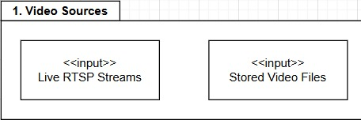
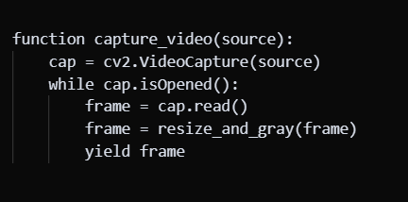
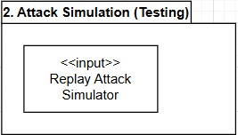
Implementation Details
1) Video Ingestion Module
Technology Used: OpenCV (Python), RTSP protocol, file I/O.
Explanation: Captures frames either from live RTSP streams or stored video files. Normalizes resolution and FPS for consistency.
Pseudocode:
Interpretation: Provides a unified stream of frames for downstream modules.
2)Replay Attack Simulator
Technology Used: Python + OpenCV, NumPy ,FFmpeg, RTSP, ffplay
Explanation: The replay attack simulator detects a “crime window” in a video, then replaces that segment with looped pre‑crime footage to generate a fake stream. It streams this manipulated video over RTSP, mimicking a real replay attack for testing your detection system.

Slide 13
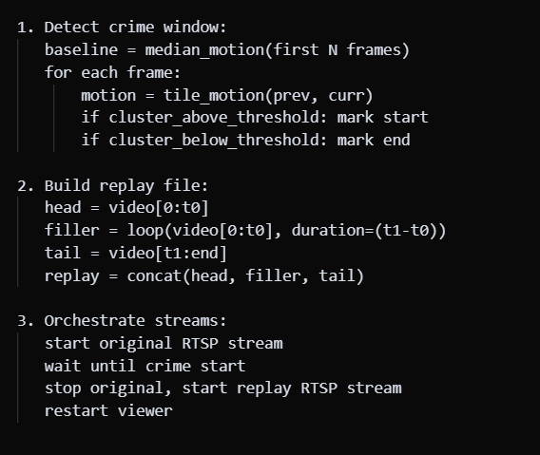
Implementation Details
Pseudocode:
Interpretation: This module simulates a replay attack by replacing crime footage with benign video and streaming it live to test and validate the detection pipeline.

Slide 14
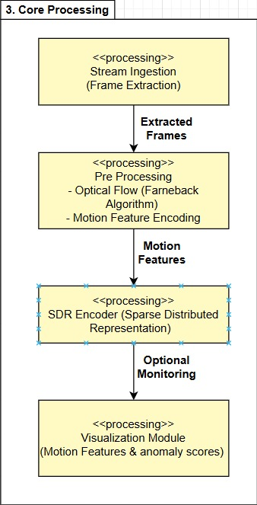
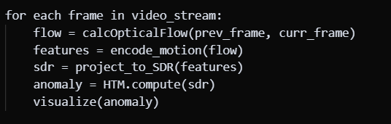
Implementation Details
3)Core Processing Pipeline
Technology Used: OpenCV, NumPy ,HTM ,Matplotlib/Custom UI
Explanation : The core pipeline ingests video frames, computes optical flow to extract motion features, and encodes them into Sparse Distributed Representations. These SDRs are processed by HTM (SP+TM) to generate anomaly scores, which are then visualized to highlight abnormal activity
Pseudocode:
Interpretation:
This stage is the heart of the system: it transforms raw video into motion features,
encodes them into SDRs, and applies HTM to detect anomalies.The visualization
module provides real‑time monitoring of anomaly scores for operators.

Slide 15
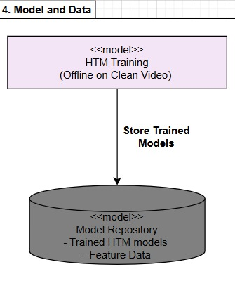
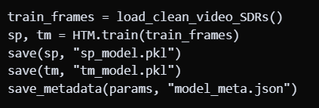
Implementation Details
4)HTM Training & Model Repository
Technology Used: HTM,Python,NumPy,Pickle/JSON
Explanation:
Offline HTM Training helps inFeed clean, normal video SDRs
into SP+TM to learn baseline motion patterns and the Model Storage saves
trained SP/TM objects and metadata (input size, thresholds, training stats)
into a repository for reusing during inference.
Pseudocode:
Interpretation:This stage builds HTM models on clean video data and stores them in a repository for consistent, reusable inference during anomaly and replay detection.

Slide 16
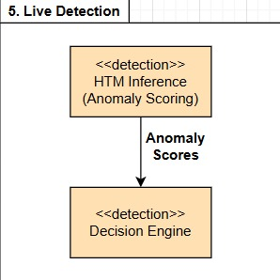
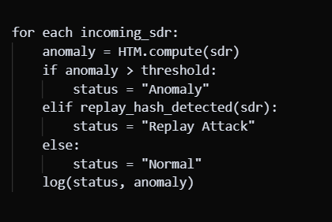
Implementation Details
5)HTM Inference & Decision Engine
Technology Used: HTM, Python + NumPy, Decision Logic / Fusion Rules for classification.
Explanation: HTM Inference uses each incoming SDR is passed through the
trained SP+TM to compute an anomaly score (0–1) and the decision Engine applies
thresholds and replay‑hash checks to classify frames as Normal, Anomaly,
or Replay Attack.
Pseudocode:
Interpretation:This stage performs real‑time anomaly scoring with HTM and fuses it with replay detection logic to deliver final live alerts.

Slide 17
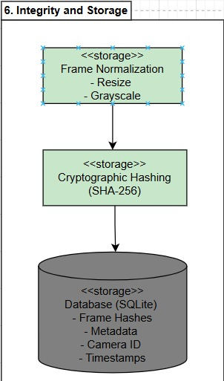
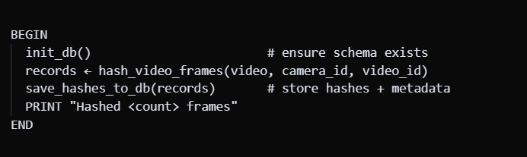
Implementation Details
6)Frame Integrity & Secure Storage
Technology Used: OpenC ,SHA‑256, SQLite
Explanation: Each incoming frame is first normalized by resizing and converting
it to grayscale for consistency across sources. A SHA‑256 cryptographic hash is
then computed to create a unique, tamper-proof fingerprint of the frame.
Finally, the hash along with metadata such as camera ID and timestamp is stored
in an SQLite database, ensuring integrity and enabling later verification.
Pseudocode:
Interpretation: This stage guarantees video integrity by hashing normalized frames and securely storing them with metadata for forensic validation.

Slide 18
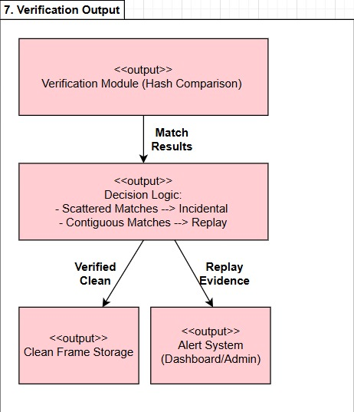
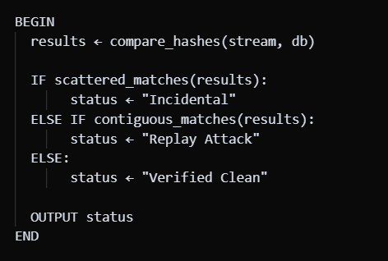
Implementation Details
7)Verification Output
Technology Used: Python ,NumPy ,SHA‑256 ,SQLite ,Decision Logic
Dashboard / Alert System
Explanation: The verification module checks incoming frame hashes against
those stored in the database. If matches are scattered, they are treated as
incidental and the frames are stored as clean. If matches are contiguous,
they indicate a replay attack and trigger the alert system. This ensures reliable
separation of genuine video from replayed evidence.
Pseudocode:
Interpretation: This stage verifies frame integrity by hash comparison, classifies match patterns as incidental or replay, and routes results either to clean storage or the alert system.

Slide 19
Project Demonstration
Exhibit the working demonstration of complete project.
It has to be complete in all aspects
Data set creation needs to be showed wherever applicable.
Note :
If any special facility required, please make sure that you have that set up. For example, if Internet connectivity is required, please have your mobile or hotspot set up.

Slide 20
Walkthrough
Demo and Product walk thru

Slide 21
Results and Discussion
The proposed system demonstrated high efficacy during validation in a simulated CCTV environment. The HTM detection module successfully identified attacks by distinguishing between normal temporal patterns and artificial replay loops, flagging threats as anomalies. Concurrently, the "Gatekeeper" mitigation logic functioned as an effective firewall, immediately blocking detected threats and ensuring only authenticated footage was committed to the trusted ledger, while the dashboard provided administrators with immediate, actionable alerts.

Slide 22
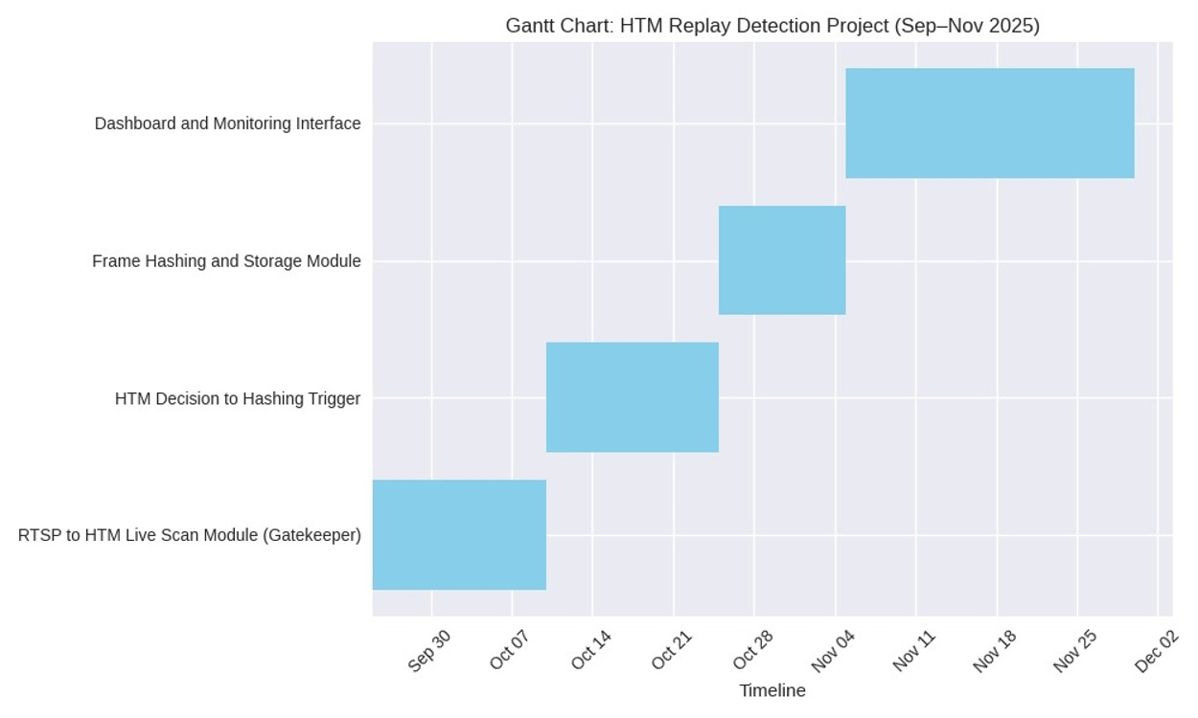
Schedule

Slide 23
Documentation
Show the evidences, status of the below documents:
Project report submitted in department?
IEEE (similar) Format of Paper current status? Which Conferences are you targeting?
Video (2-3 minutes) of your project? Please Play.
Add the Github repository link.
All artifacts of your project uploaded in the CSE Project repository?

Slide 24
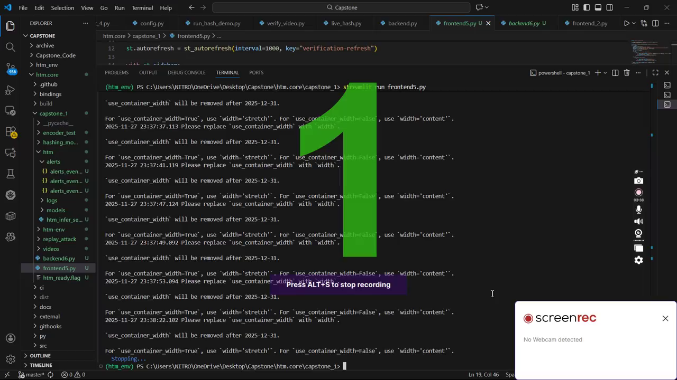
Inference for Normal Video

Slide 25
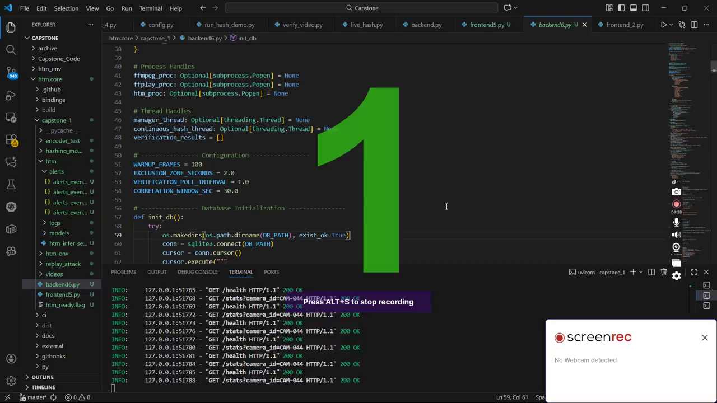
Inference for Replayed Video

Slide 26
Github Link
https://github.com/SoumyaMishra03/Replay_Attack_Detection

Slide 27
Lessons Learnt
Feature Extraction Refinement: Initial challenges with optical flow sensitivity to noise and lighting necessitated a refinement of the preprocessing pipeline for more stable motion detection.
HTM Parameter Tuning: Tuning Hierarchical Temporal Memory (HTM) parameters and setting effective anomaly thresholds required iterative experimentation and a deep understanding of temporal data behavior.
Perceptual Hashing (pHash) Resilience: Learned the significance of selecting a pHash method specifically resilient to minor visual changes common in compressed or low-light video streams.
Generalizability Improvement: If starting over, more time would be allocated to dataset preparation and testing under diverse environmental conditions to improve system generalizability.
Major Challenges Overcome: Successfully tackled managing false positives in anomaly detection, synchronizing hash comparisons with frame-level analysis, and ensuring sustained real-time performance without sacrificing accuracy.
Soft Skills Reinforced: Emphasized the practical value of adaptability, collaboration, and continuous learning in solving complex, real-world security challenges.

Slide 28
Conclusion and Future work
Pioneering Hybrid Approach: Successfully fuses Hierarchical Temporal Memory (HTM) with Perceptual Hashing (pHash) to counter sophisticated CCTV replay attacks.
Real-Time Anomaly Detection (HTM): Utilizes HTM's unsupervised learning to autonomously model normal temporal motion patterns, enabling instant flagging of behavioral deviations.
Robust Content Verification (pHash): pHash complements HTM by providing resilience against compression and noise, effectively detecting visually repeated "canned" content.
Superior Reliability: Achieved minimal false positives and high reliability through the combined architecture and the implementation of adaptive thresholding logic.
Enhanced Analysis: The system significantly enhances both real-time mitigation capabilities and post-event forensic analysis.
Future Scaling: Development includes pHash optimization against artifacts and deployment of the system onto edge devices for scalability in multi-camera environments.

Slide 29
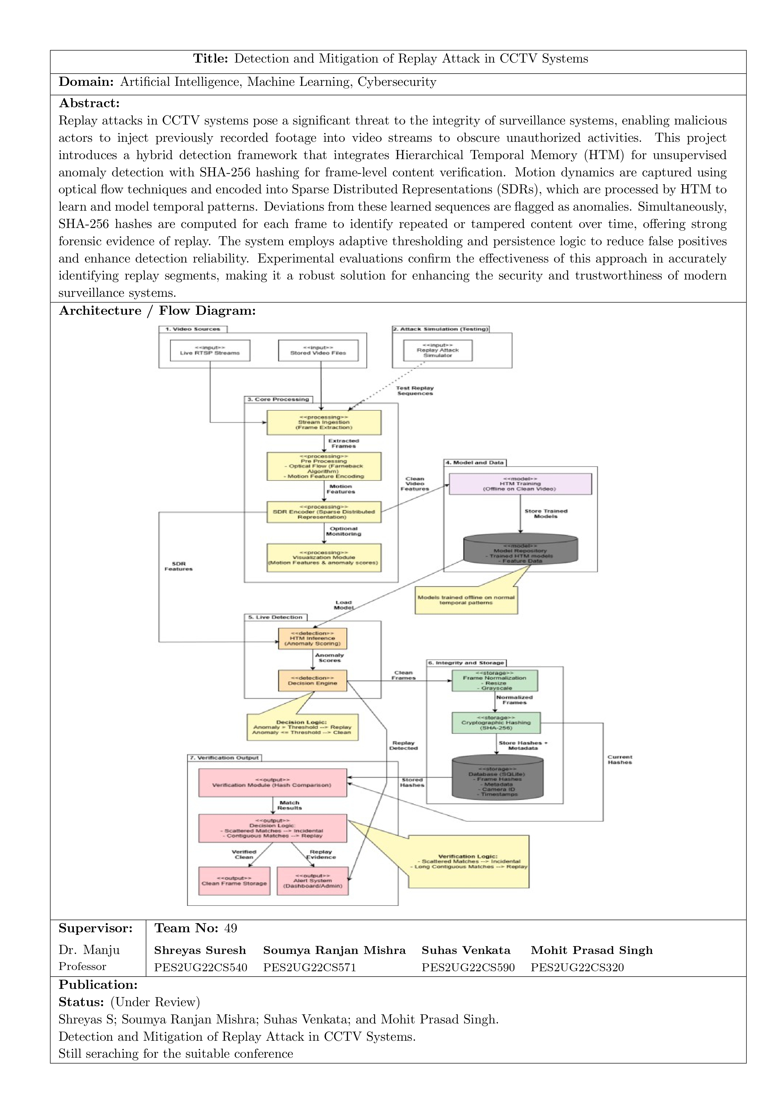
Project Abstract

Slide 30
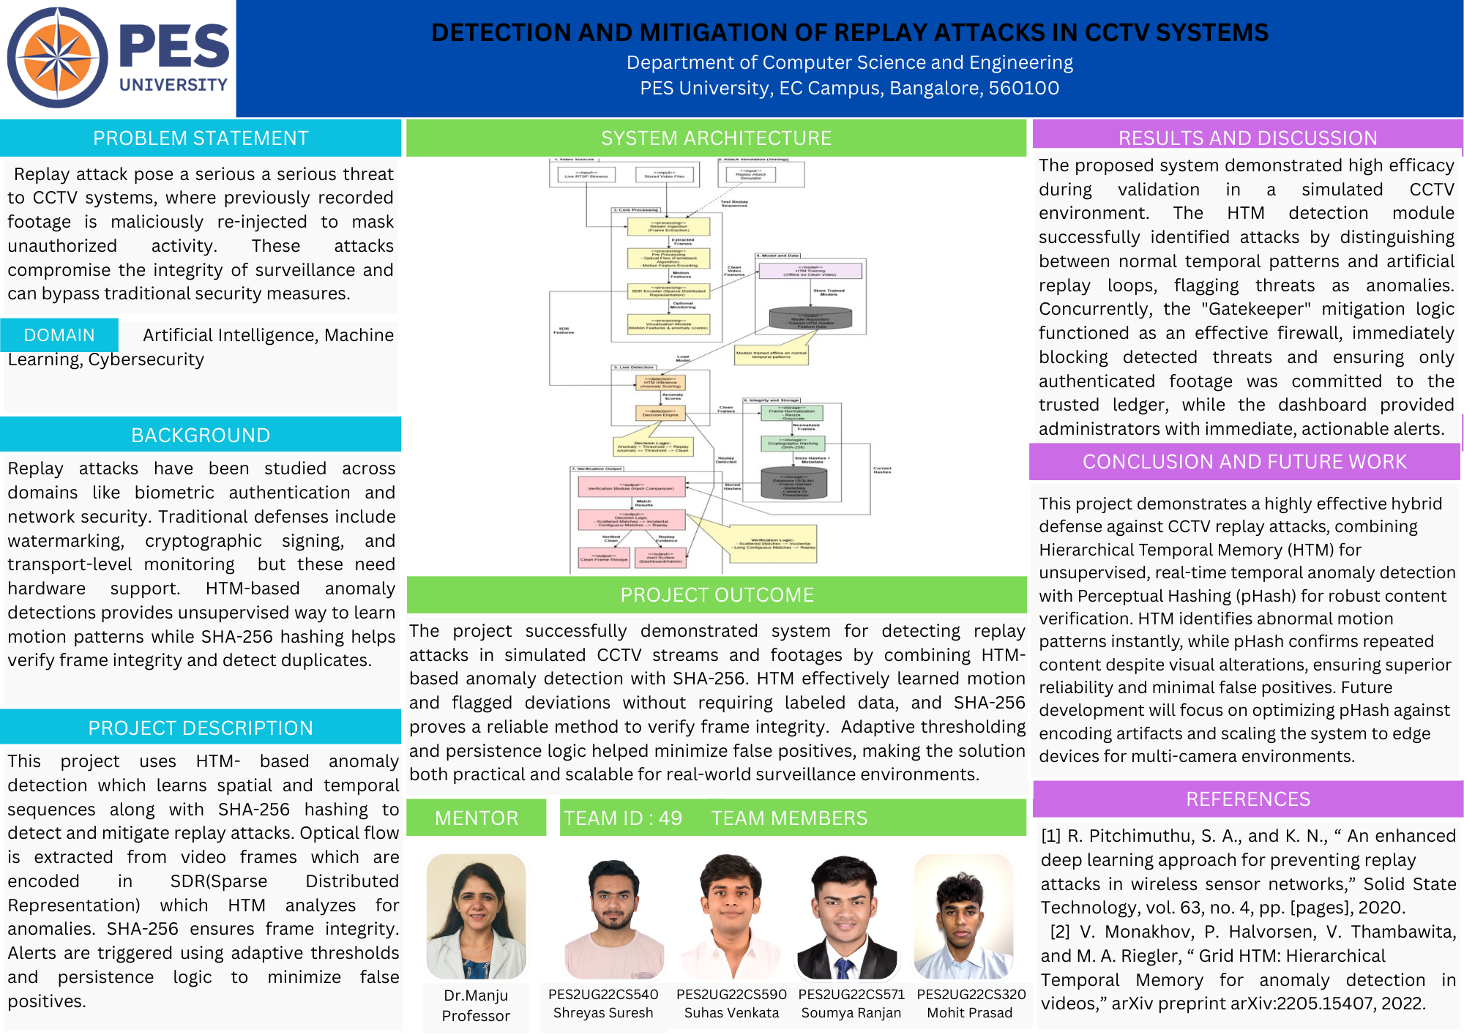
Project Poster

Slide 31
References
[1] D. Zhao, B. Yang, Y. Li, and H. Zhang, "Replay Attack Detection for Cyber-Physical Control Systems: A Dynamical Delay Estimation Method," IEEE Transactions on Industrial Electronics, vol. 71, no. 6, pp. 6263-6273, Jun. 2024, doi: 10.1109/TIE.2024.3406859.
[2] S. Gupta and T. S. Gopi, "Anomaly Detection in Surveillance Videos Using Hierarchical Temporal Memory," in Proc. 24th International Conference on Pattern Recognition (ICPR), pp. 1234–1239, 2018.
[3] A. Patel and M. Z. A. Khan, "Optimal Chi-squared Detector of Replay Attacks on Cyber-Physical Systems," in Proc. 2021 9th Int. Conf. Systems and Control (ICSC), Caen, France, 2021, pp. 338–343. DOI:10.1109/ICSC50472.2021.9666502.
[4] V. Monakhov and V. Kulyukin, "Grid HTM: Hierarchical Temporal Memory for Anomaly Detection in Videos," arXiv preprint arXiv:2205.15407, 2022. [Online]. Available: https://arxiv.org/abs/2205.15407
[5] Numenta, Inc., "The Science of Anomaly Detection: How HTM Enables Anomaly Detection in Streaming Data," Numenta White Paper, 2019. [Online]. Available: https://www.numenta.com/assets/pdf/whitepapers/Numenta%20White%20Paper%20-%20Science%20of%20Anomaly%20Detection.pdf

Slide 32
Thank You

